Slide 1
Crownpeak Architecture

Slide 2





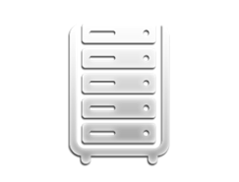


Core Architecture: Management vs. Delivery
End
User
Core Content Management
Delivery
Template-Managed I/O
Input Processing
Output Generation
Policies and Standards
System
Dynamic Services
Repository
(content, security, workflow)
Targeting and Personalization
Search Management
Content Management
Presentation layer

Slide 3
Core Architecture: Any Deployment Target
Core Content Management
Delivery
Template-Managed I/O
Crownpeak-Hosted Platform
Input Processing
Output Generation
Policies and Standards
Customer-Hosted Platform
Repository
Third-Party Service
(e.g. AWS, Azure, Rackspace, Google Cloud)
Content Management
Content Delivery

Slide 4
Core Architecture: Any Technology
Core Content Management
Delivery
Template-Managed I/O
Input Processing
Output Generation
Java EE (JSP)
.Net (ASP)
Policies and Standards
PHP
XML
Repository
JSON
anything …
Content Management
Content Delivery

Slide 5
Implementation Process

Slide 6
CMS Implementation Process
Design iterations
Final design / build
Acceptance Testing
Launch
Maintenance
CMS Implementation
Content Entry

Slide 7
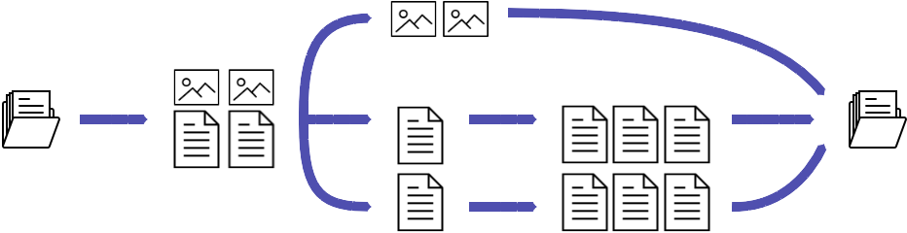
q
Final build resources.
w
Split resources into
  “digital assets” (no content management) such as png, jpg, mp4, js?, css? etc.; and
  “templated assets” (content management required).
Identify page / elements “archetypes” (landing page, press release, article etc.)
e
Digital assets uploaded
as-is.
Create CMS templates for each archetype.
Create CMS models to allow creation of content assets using the templates.
r
Use CMS models to create content assets.
t
Publish all assets.

Slide 8
Implementation Approaches
Component Library
Design- or markup-centric
Uses code generation
Classic Templating
Code-centric
Fast time to value
Encourages code re-use
Can dive into the code to customize
Greatest degree of control
Non-markup outputs
Integrations
Longer compile times
Debugging complexity
Greater C#/.Net knowledge required
Slower time to value

